Slide 1
Data Science Applied Accident Analysis

Slide 2
Introduction
There are a lot of vehicles driving on the roadway every day in India, and traffic accidents could happen at any time anywhere.
There are many phases included in, human population, vehicle population(motorcycle, car, lorry)and if it is calculated for total number of accident I the year, recent for the accidents, it provides a comprehensive analysis of report is find out the number of person killed/year and injured for (Grievous/minor) in a road traffic accidents.
This project is attempted to analyze the road accident data in Bengaluru based on dataset provided by Intel's Collision Detection System (CDS) or Collision Avoidance System (CAS) sensors installed in buses in 2018.

Slide 3
Data Details
Device Code: Unique device code for the CAS installed in the vehicles
Latitude: Latitude of the location where the collision warning was generated
Longitude: Longitude of the location where the collision warning was generated
Ward Name: Bangalore ward in which this location details latitude and longitude falls under
Type of Alarm: The type of collision alert generated by the collision avoidance system
Recorded Date and Time: Date and time at which the alert was generated
Speed: Speed of the vehicle at the time when the collision alert was generated. Values of all the speed are in km/hr.

Slide 4
Collision Detection System Alarm types
FORWARD COLLISION WARNINGS (FCW)
URBAN FORWARD COLLISION WARNINGS (UFCW)
HEADWAY MONITORING WARNING (HMW)
LANE DEPARTURE WARNINGS (LDW)
PEDESTRIANS AND CYCLIST DETECTION AND COLLISION WARNING (PCW)
OVERSPEEDING

Slide 5
Data generation
The dataset for this project is generated based on available datasets for traffic analysis. The dataset is created for a different location in Bangalore like Kadugodi, Garudachar Playa,
Hudi with various types like Overspeed, UFCW, HMW. For easy understanding. The dataset will be given in the form of a .csv file.

Slide 6
Feature Identification
The necessary features for the project are to be identified like device location, latitude, longitude, speed, time and date etc. The features which are associated with the project
are identified for the dataset by using which the analysis could be easily performed.

Slide 7
Feature extraction
Feature extraction will in general make use of the dimensionality reduction procedure to reduce and consider only those necessary attributes necessary for the project like time, speed, location between the locations

Slide 8
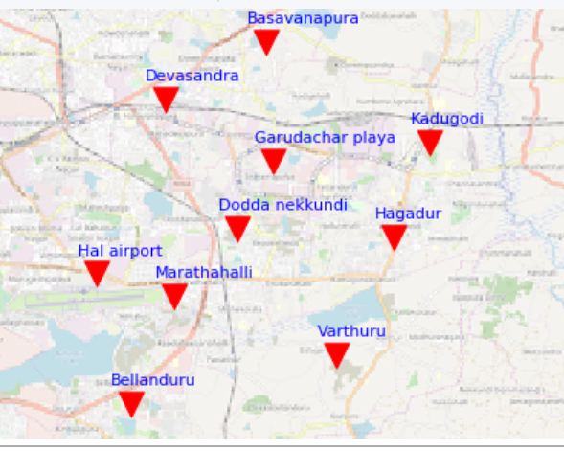
Conclusion – Top most Accident Zones

